Slide 1

DATA ANALYSIS OF GENERAL ELECTION OF PARLIAMENTARY / ASSEMBLY CONSTITUENCIES:TRENDS & RESULTS- 2024
-K.SRI ABHINAYA

Slide 2
10 INSIGHTS FROM THE DATA SET.
STATE THE VOTE COUNT & VOTE SHARE IN PARLIAMENTARY CONSTITUENCY GENERAL.
ANALYSE THE ELECTIONS IN ANDHRA PRADESH VIA COMPARING MLA SEATS.
ANALYSE THE ELECTIONS IN ANDHRA PRADESH VIA COMPARING MP SEATS.
ANALYSE THE ELECTIONS IN ODISHA VIA COMPARING MLA SEATS.
ANALYSE THE ELECTIONS IN ODISHA VIA COMPARING MP SEATS.
ANALYSE THE ELECTIONS IN ARUNACHAL PRADESH VIA COMPARING MLA SEATS.
ANALYSE THE ELECTIONS IN ARUNACHAL PRADESH VIA COMPARING MP SEATS.

Slide 3
ANALYSE THE ELECTIONS IN SIKKIM VIA COMPARING MLA SEATS.
ANALYSE THE ELECTIONS IN SIKKIM VIA COMPARING MP SEATS.
PRESENT RULING PARTIES VIA STATES & CENTRAL.

Slide 4
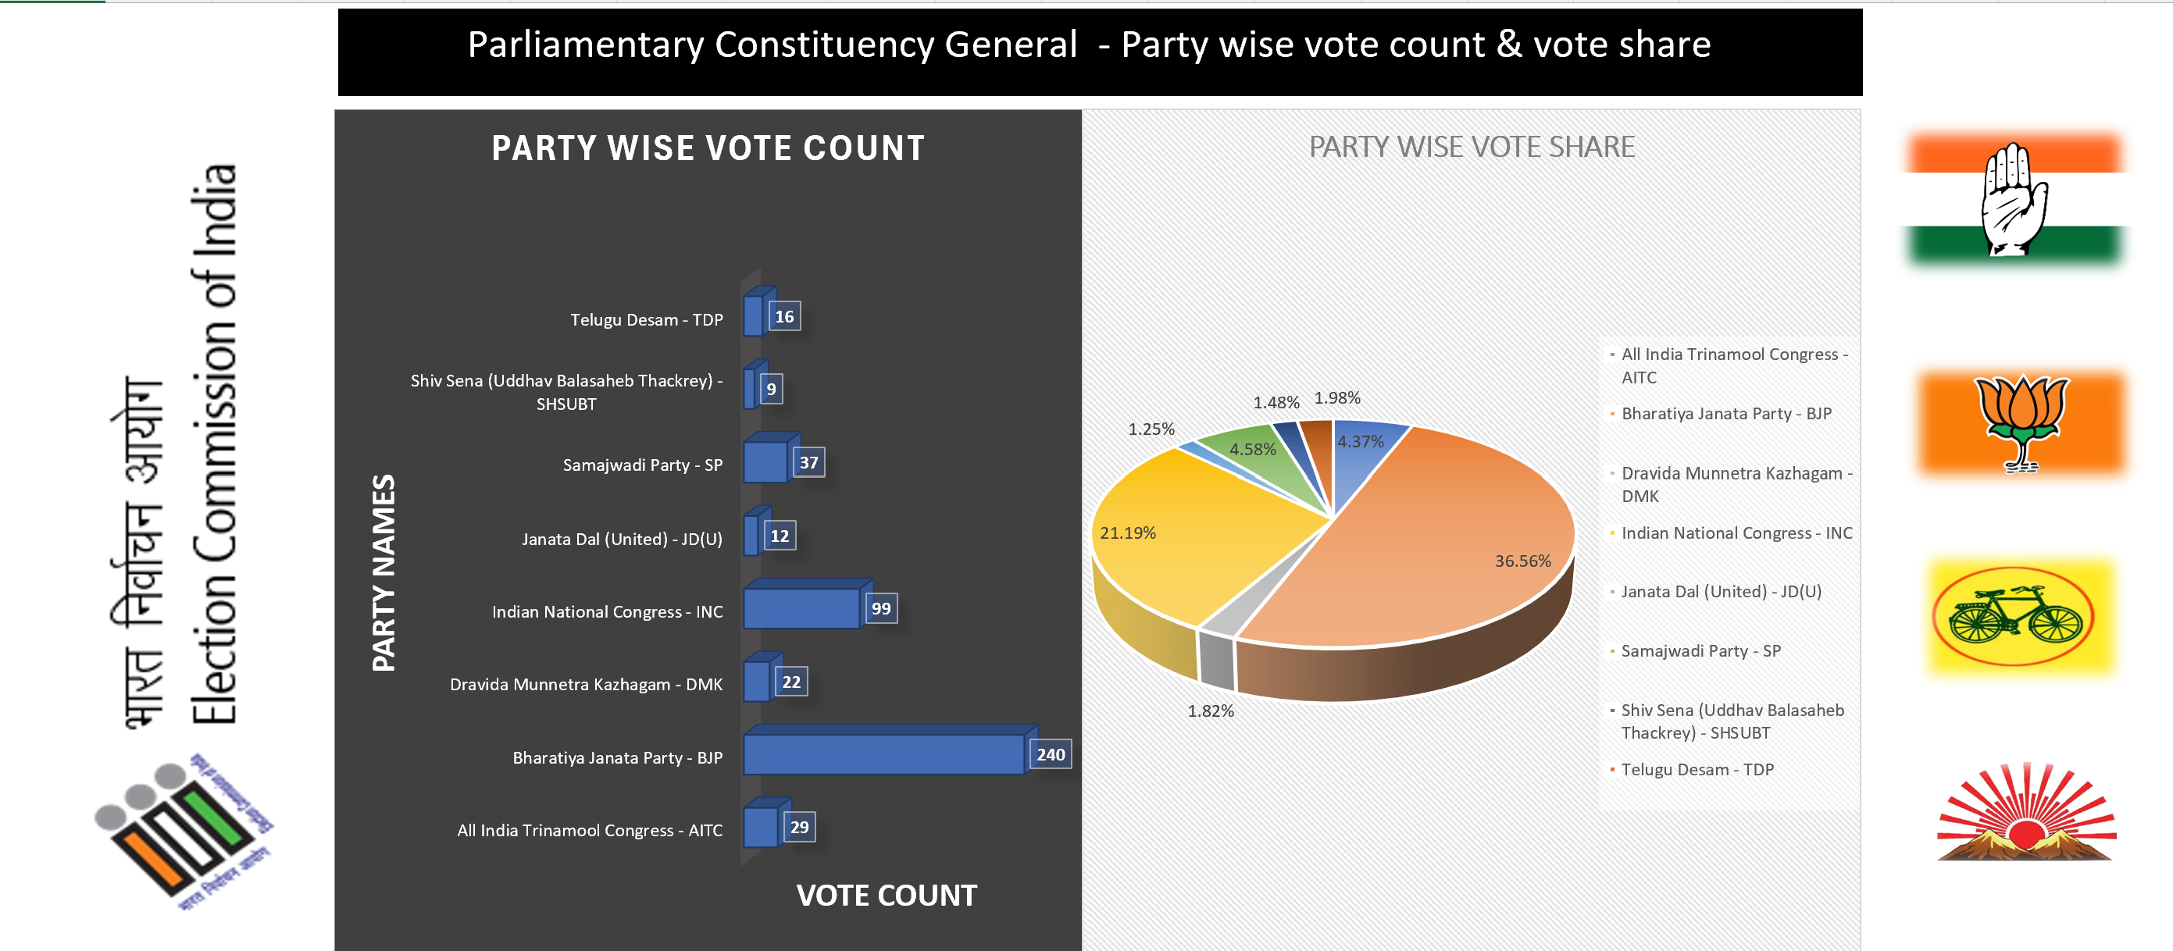
1.STATE THE VOTE COUNT & VOTE SHARE IN PARLIAMENTARY CONSTITUENCY GENERAL.

Slide 5
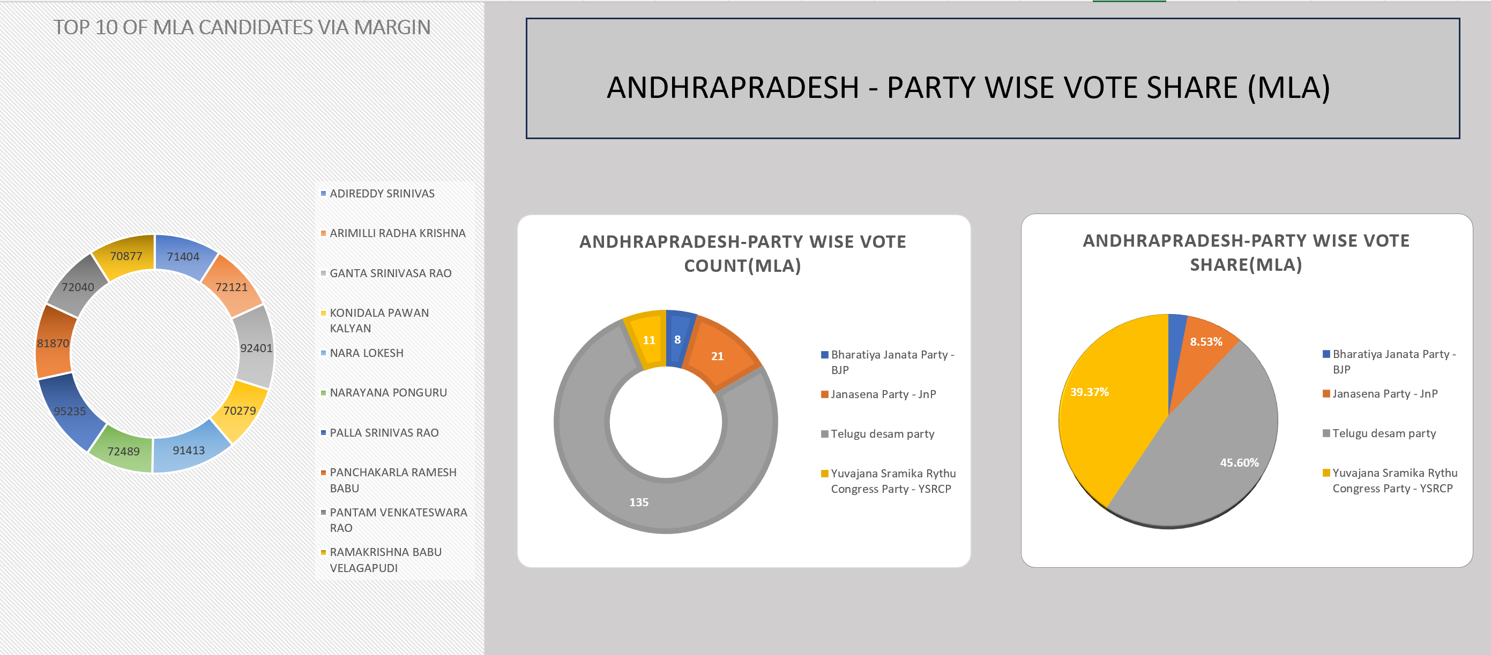
2. ANALYSE THE ELECTIONS IN ANDHRA PRADESH VIA COMPARING MLA SEATS.

Slide 6
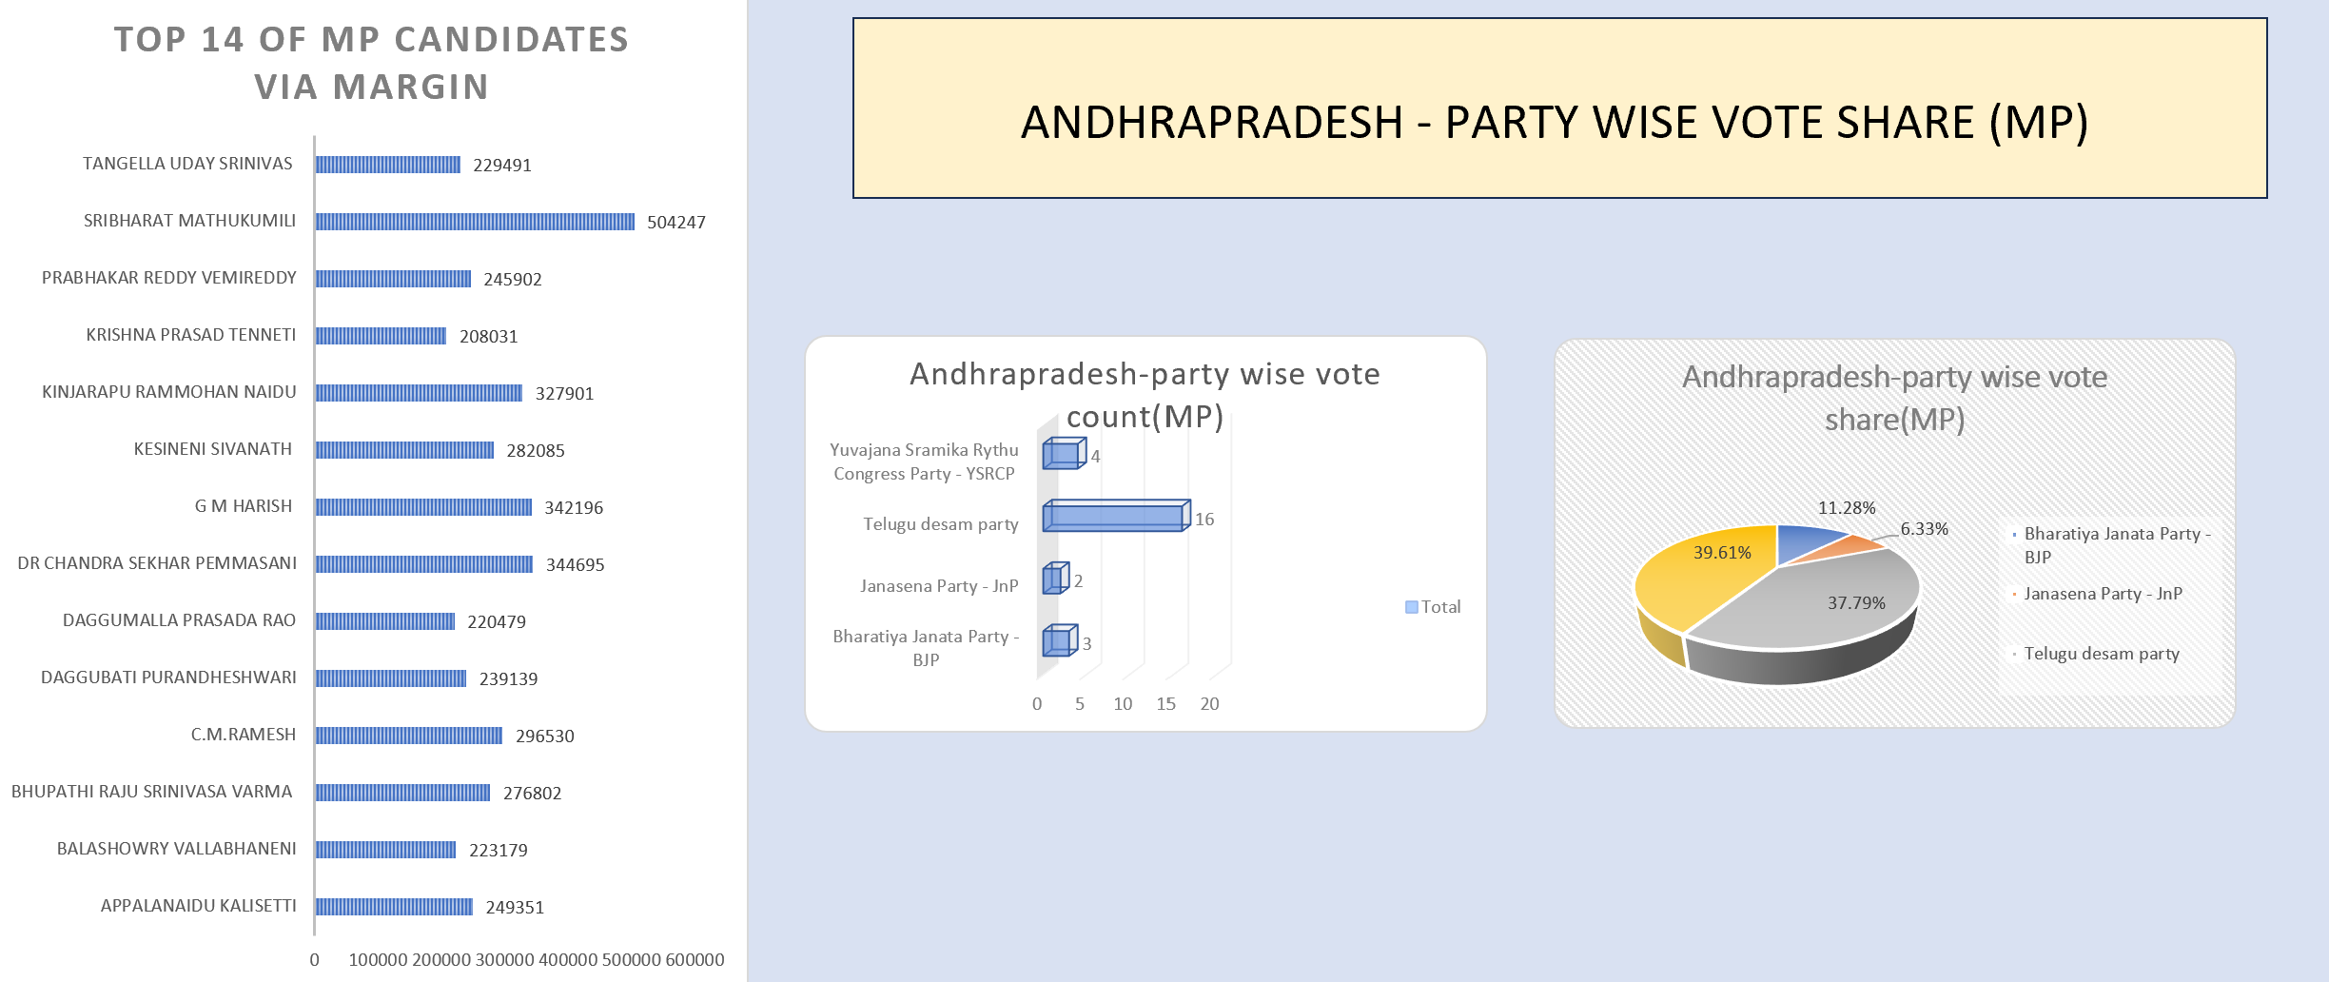
3. ANALYSE THE ELECTIONS IN ANDHRA PRADESH VIA COMPARING MP SEATS.

Slide 7
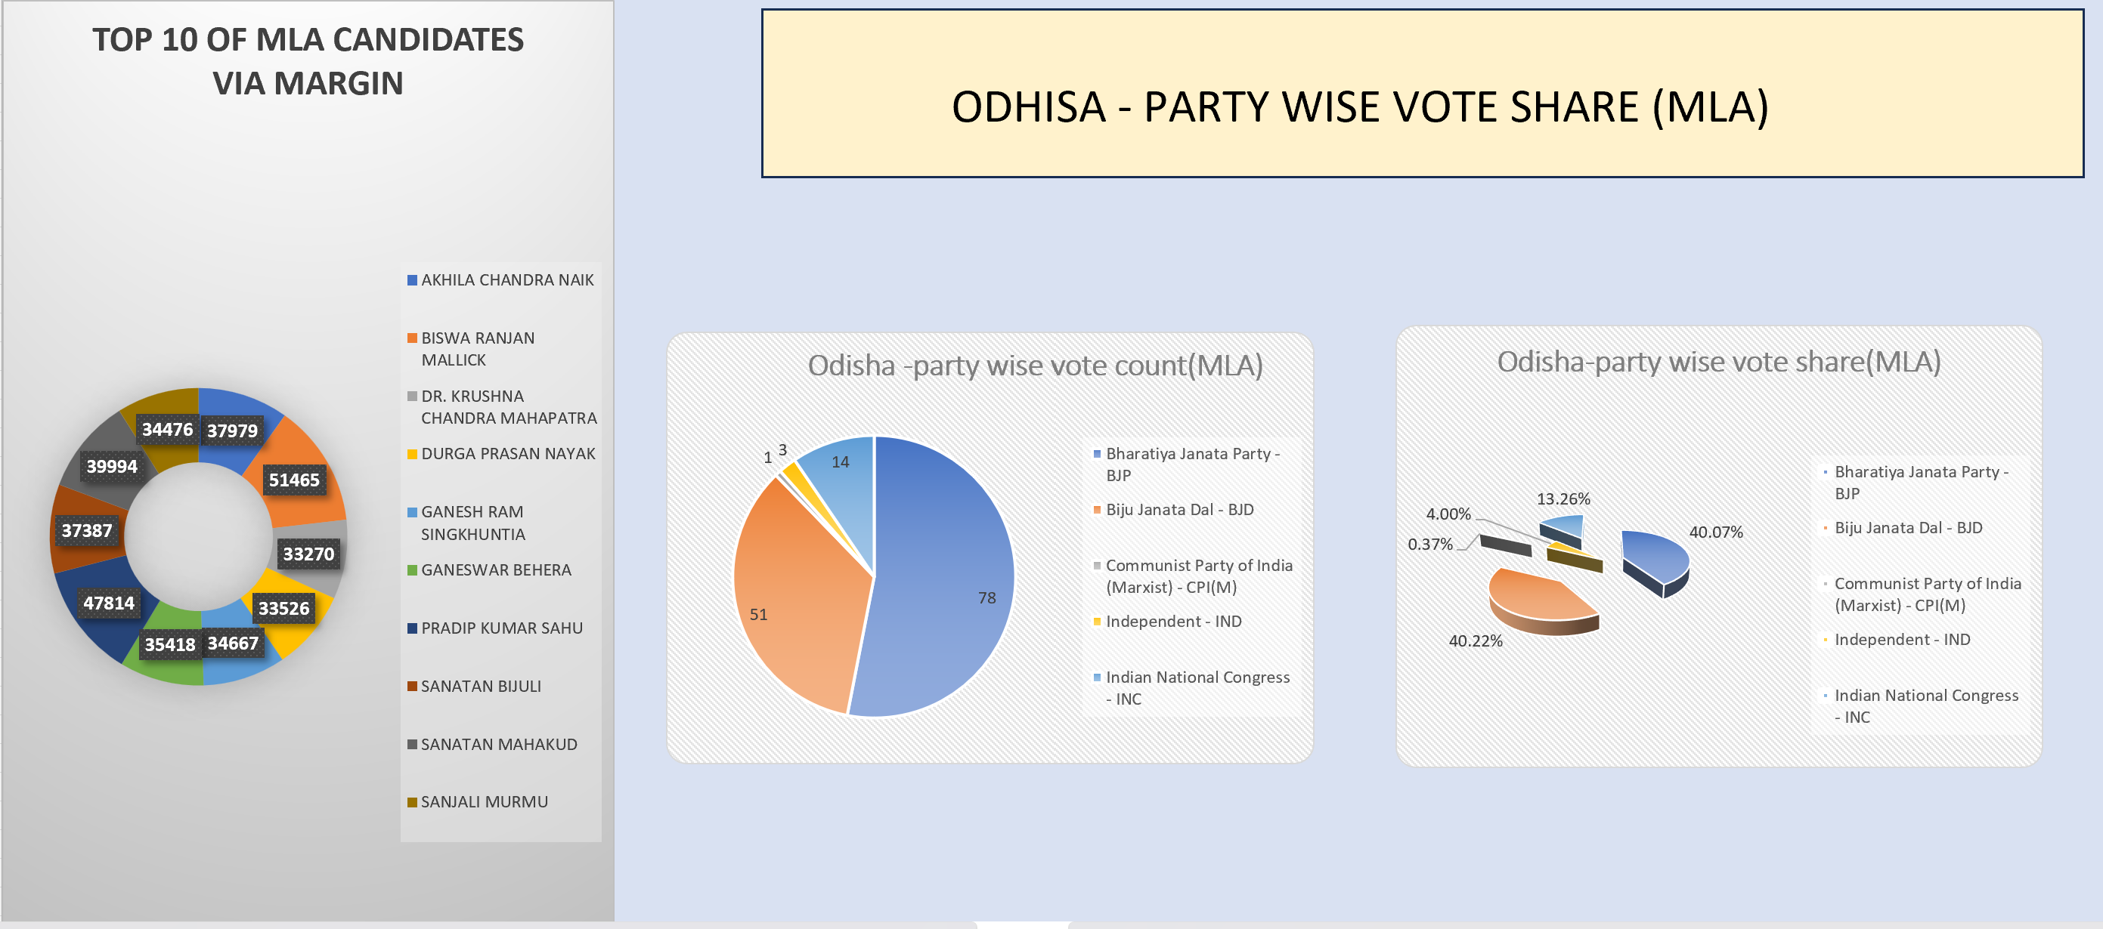
4. ANALYSE THE ELECTIONS IN ODISHA VIA COMPARING MLA SEATS.

Slide 8
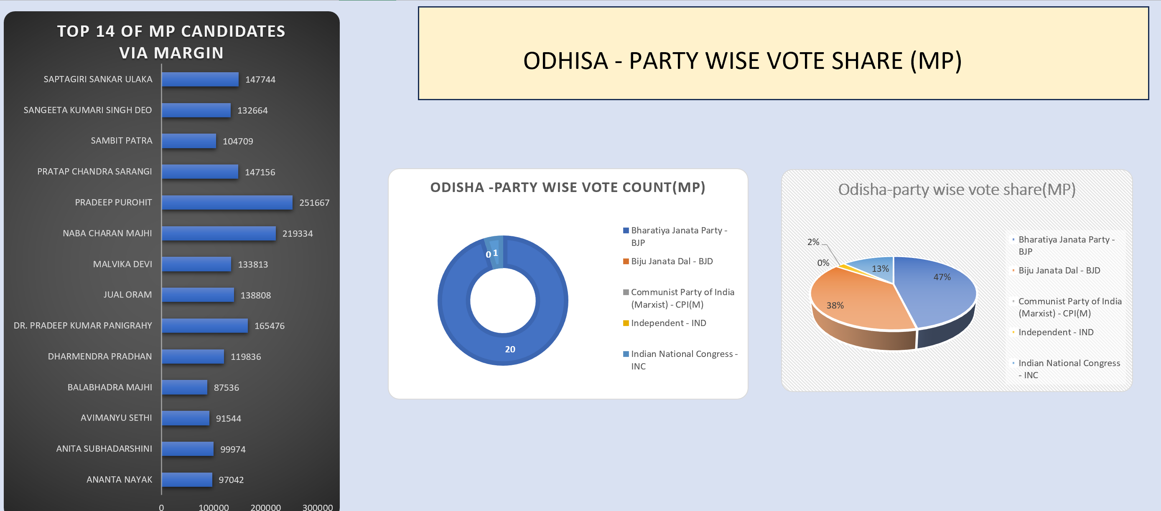
5. ANALYSE THE ELECTIONS IN ODISHA VIA COMPARING MP SEATS.

Slide 9
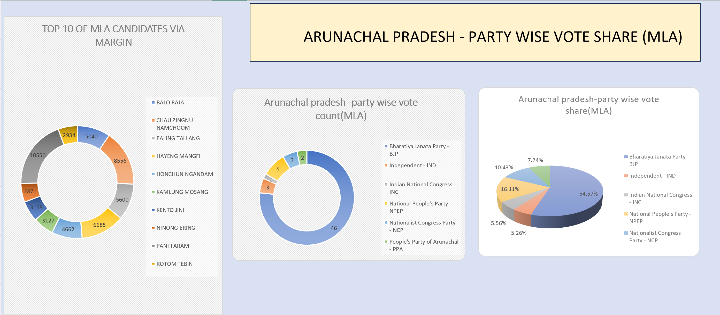
6. ANALYSE THE ELECTIONS IN ARUNACHAL PRADESH VIA COMPARING MLA SEATS.

Slide 10
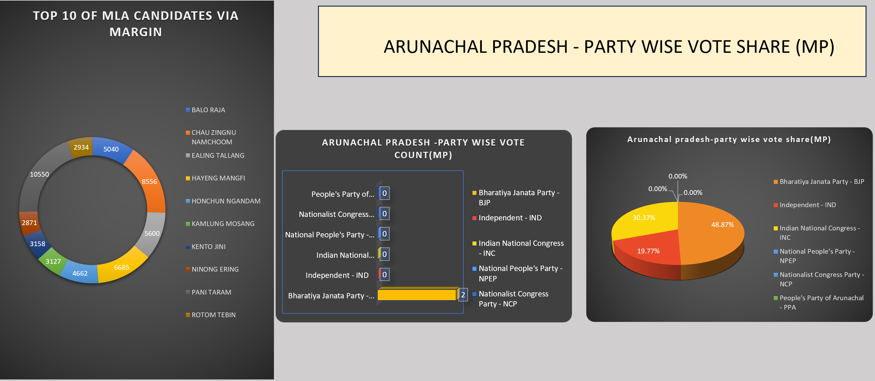
7. ANALYSE THE ELECTIONS IN ARUNACHAL PRADESH VIA COMPARING MP SEATS.

Slide 11
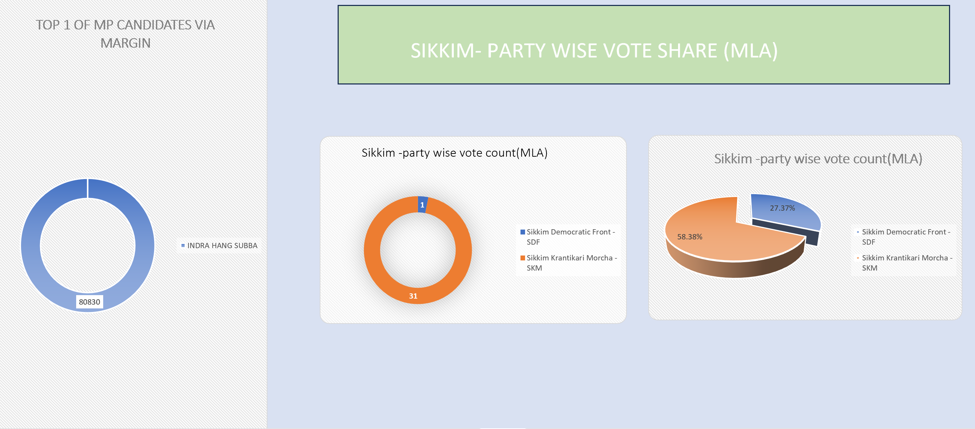
8. ANALYSE THE ELECTIONS IN SIKKIM VIA COMPARING MLA SEATS.

Slide 12
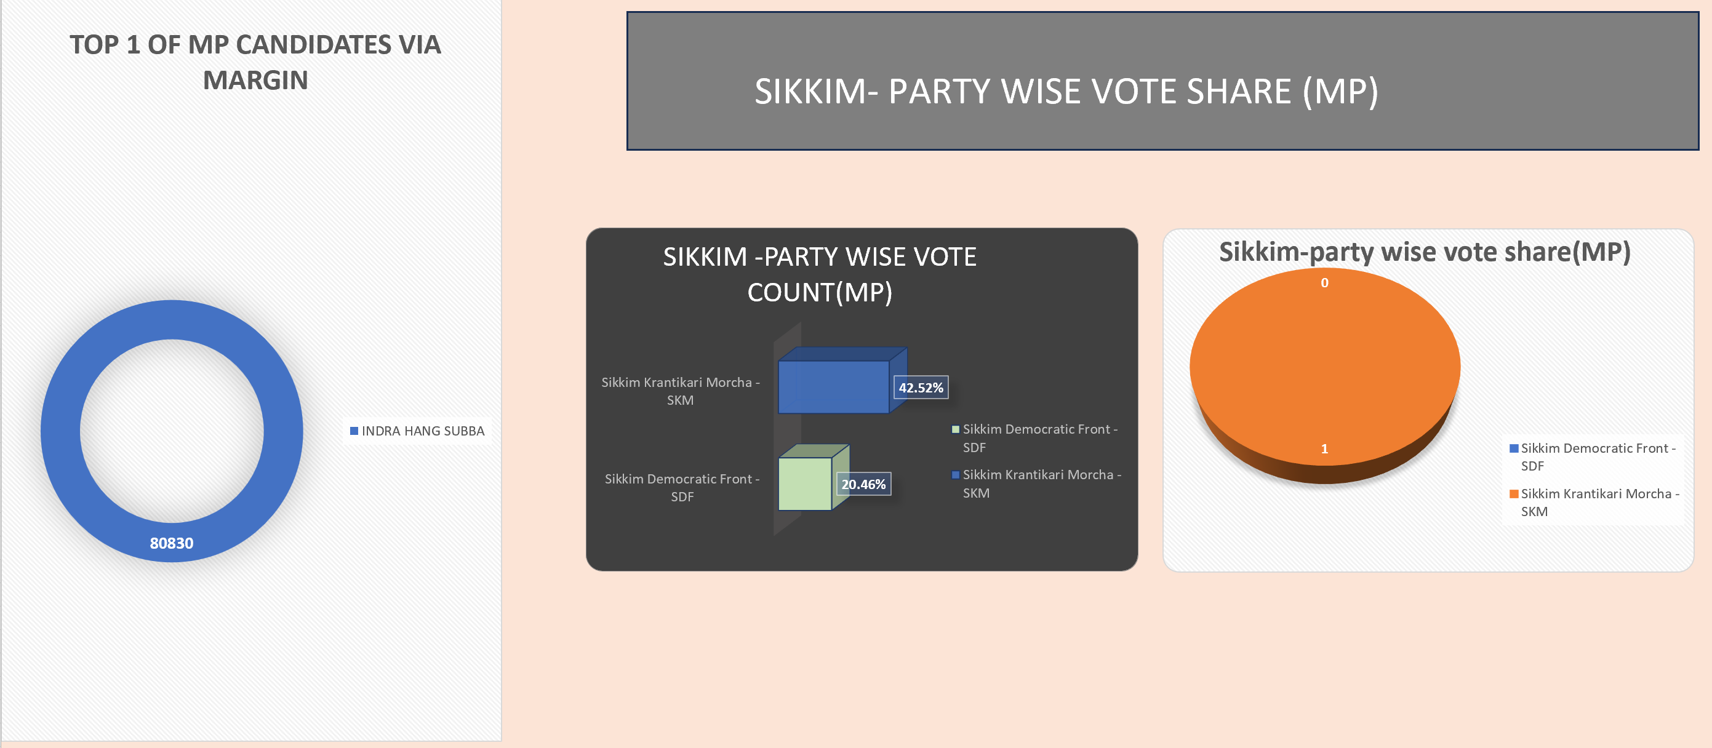
9. ANALYSE THE ELECTIONS IN SIKKIM VIA COMPARING MP SEATS.

Slide 13
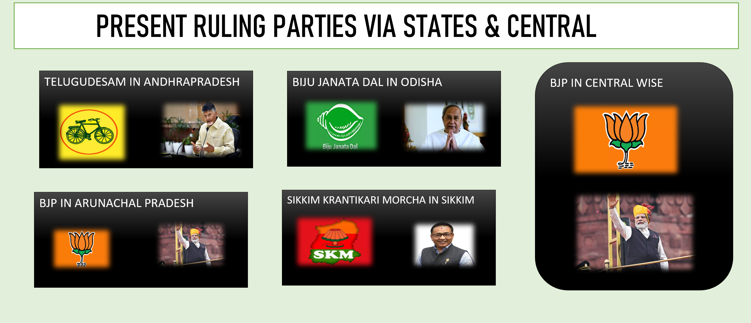
10. PRESENT RULING PARTIES VIA STATES & CENTRAL

Slide 14


